Slide 1

Department of Computer Science and Engineering
Glaucoma Diagnosis Using Deep Learning and Machine Learning
PRESENTED BY
Duggireddy Dhana Lakshmi (21471A0584)
Shaik Rizwana (21471A05C4)
Shaik Mubeena (21471A05C1)
Under the Guidance of,
Marella Venkata Rao Assistant Professor,
Department of Computer Science and Engineering,
Narasaraopeta Engineering College (Autonomous),
Narasaraopet- 522 601.

Slide 2
OUTLINE
Abstract
Introduction
Literature Survey
Research Gaps
Problem Statement
Objectives
Block Diagram / Flow Diagram
Methodology
Implementation
Results and Analysis
Conclusion & Future Scope
References
Questions and Answers
Acknowledgements

Slide 3
ABSTRACT
The glaucoma diagnosis model utilizes Machine Learning and Deep Learning with CNN architectures like ResNet50 and VGG-16. Post-processing rules refine predictions to assess the overall risk of glaucoma.
Cataracts, which cause blindness by damaging the optic nerve, are often confused with glaucoma, but advanced machine-learning techniques help in accurate differentiation.
The model significantly improves glaucoma detection using medical imaging data and achieves 96% accuracy, 99.37% precision, 88.50% recall, and a 93.60% F1 score.
The ensemble framework combining ResNet50, VGG-16, and Random Forest enhances correctness, exactness, retrieval, and overall performance. Early detection with this approach helps prevent vision loss, and the integration of Machine Learning and Deep Learning offers promising advancements for ophthalmic healthcare.

Slide 4
INTRODUCTION
Introduction
Glaucoma is a chronic eye condition that leads to irreversible blindness if not diagnosed and treated early.
With its global prevalence rising, early detection has become a critical focus for the healthcare community.
This project aims to develop an efficient and accurate system for glaucoma diagnosis by leveraging advanced machine learning and deep learning techniques to analyze retinal fundus images.
Motivation Behind the Project
The motivation stems from the significant burden glaucoma imposes on individuals and healthcare systems worldwide. Traditional diagnostic methods are often time-consuming and require expert intervention.
By automating the process using artificial intelligence, the project addresses the need for accessible, quick, and reliable screening solutions, particularly in underserved areas.

Slide 5
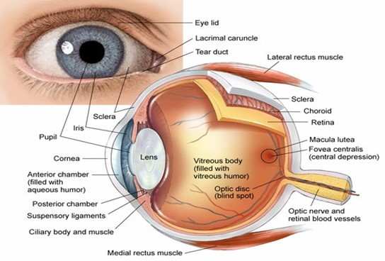
Importance and Relevance This work is vital as it provides a scalable and accurate tool for early glaucoma detection, helping prevent vision loss. Integrating AI-driven methods in ophthalmology enhances diagnostic efficiency and broadens access to quality care, especially in regions with limited medical resources.

Slide 6
LITERATURE SURVEY
S.No | Title | Author | Journal Name & Year | Methodology Adapted | Key Findings | Gaps
1 | Deep Learning and Computer Vision for Glaucoma Detection | Mona Ashtari-Majlan, Mohammad Mahdi Dehshibi, David Masip | ArXiv Preprint, 2023 | The paper reviews AI-based glaucoma diagnosis, focusing on deep learning methods, datasets, metrics, and feature extraction. | The study highlights deep learning's progress in glaucoma detection and key gaps in its application. | Data bias, poor generalization, uncertainty, multimodal issues, low interpretability.
2 | Glaucoma Detection Using Deep Learning | Sneha Suresh Vanjire, Sreelakshmi, Merin Meleet | International Journal of Research Publication and Reviews, 2021 | A CNN-based fully automated system was developed for glaucoma detection using retinal fundus images, with training and inference phases. | The proposed CNN model achieved 80% accuracy in classifying glaucoma stages. | Limited dataset size, need for more diverse data, and lack of classification for moderate-stage glaucoma.
3 | Automatic Feature Learning for Glaucoma Detection Based on Deep Learning | Xiangyu Chen, Yanwu Xu, Shuicheng Yan, Damon Wing Kee Wong, Tien Yin Wong, Jiang Liu | MICCAI 2015, Lecture Notes in Computer Science (LNCS 9351) | The study introduces ALADDIN, a deep learning framework that embeds micro neural networks (MLPs) within CNNs for glaucoma detection. | Achieved high AUC (0.838 ORIGA, 0.898 SCES). | Limited to fundus images and two datasets. Lacks multi-disease detection.

Slide 7
LITERATURE SURVEY
S.No | Title | Author | Journal Name & Year | Methodology Adapted | Key Findings | Gaps
4. | A Hybrid Framework for Glaucoma Detection Through Federated Machine Learning and Deep Learning Models | Abeer Aljohani, Rua Y. Aburasain | BMC Medical Informatics and Decision Making, 2024 | A hybrid CNN-ML framework with grayscale preprocessing, GLCM feature extraction, and ensemble learning was developed for glaucoma detection. | Achieved 95.41% accuracy, 99.37% precision, 88.33% recall, and 93.52% F1 score. | The study is limited to fundus images, lacks multimodal data, and needs broader clinical validation for generalizability.
5. | Systematic Development of AI-Enabled Diagnostic Systems for Glaucoma and Diabetic Retinopathy | Khursheed Aurangzeb, Rasha Sarhan Alharthi, Syed Irta za Haider, Musaed Alhussein | IEEE Access, 2023 | A modified ColonSegNet model with contrast enhancement, data augmentation, and vessel segmentation was developed for early glaucoma and DR detection. | The modified ColonSegNet model achieved an accuracy of 96.6% (DRIVE), 97.1% (CHASE_DB), and 97.2% (STARE) for retinal vessel segmentation. | The model struggles with thin vessel segmentation, lacks multimodal data, and needs further optimization for clinical validation.

Slide 8
RESEARCH GAPS
1. Dataset Bias
Gap: Limited representation of heterogeneous groups (e.g., ethnicity and age).
Improvement: References to datasets that represent a wider range of populations to help reduce biases.
2. Evaluation Against Advanced Techniques
Gap: Missing references to methods that work better than current ones in real-world clinical settings.
Improvement: Include studies on advanced architectures (e.g. hybrid models → refer to approaches that combine two or more different techniques,).

Slide 9
3. Integration with Other Tools Gap: Missing references for combining retinal images with OCT (Optical Coherence Tomography)(to capture high-resolution images of the retina and other tissues) or other modalities for multimodal analysis. Improvement: Reference studies on hybrid systems for glaucoma detection and diagnosis. 4. Real-Time Deployment Challenges Gap: Absence of studies focusing on the difficulties of deploying models in low-resource settings. Improvement: Refer to studies concentrating on optimized models.
RESEARCH GAPS

Slide 10
PROBLEM STATEMENT
Problem Definition
This study focuses on improving traditional glaucoma detection methods, which are slow, difficult to access, and often rely on human interpretation, leading to mistakes and delays.
Significance
Early glaucoma detection is key to preventing permanent blindness.
An automated, accurate, and scalable system can make diagnosis more accessible and reduce blindness, especially in areas with fewer resources.

Slide 11
OBJECTIVES
1. Create an automated glaucoma detection system using cutting-edge machine learning and deep learning methods.
2. Utilize retinal fundus images for reliable and precise feature extraction and analysis
3.Integrate ensemble methods like ResNet50, VGG-16, and Random Forest to enhance diagnostic accuracy.
4. Test the framework with various datasets to confirm its scalability and dependability in practical applications.

Slide 12
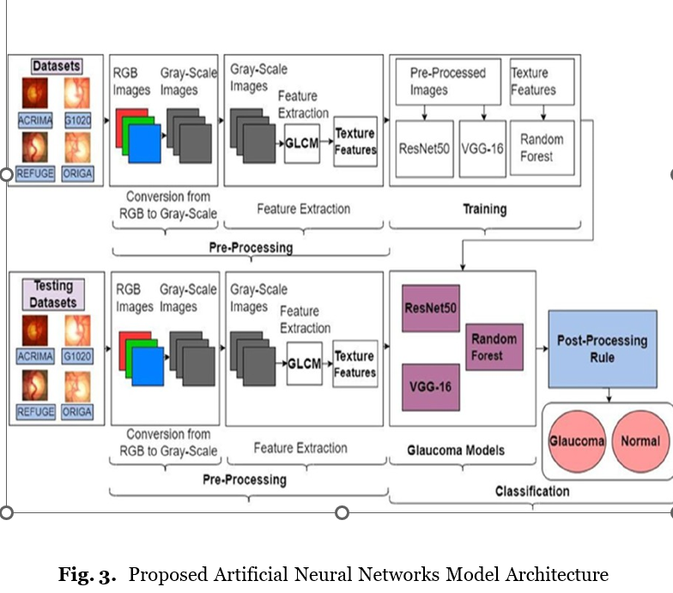
BLOCK DIAGRAM OR FLOW DIAGRAM

Slide 13
BLOCK DIAGRAM OR FLOW DIAGRAM
1. Datasets Used:
ACRIMA, G1020, REFUGE, ORIGA retinal fundus image datasets.
2. Pre-Processing:
RGB to Grayscale Conversion: Converts color images to grayscale for better feature extraction.
Feature Extraction using GLCM (Gray-Level Co-Occurrence Matrix): Extracts texture features from grayscale images.
3. Training Phase:
Pre-processed images and extracted texture features are used for training.
Models Used:
ResNet50 (Deep CNN for feature extraction).
VGG-16 (Deep CNN for feature extraction).
Random Forest (Machine learning model for classification).

Slide 14
BLOCK DIAGRAM OR FLOW DIAGRAM
4. Testing Phase:
Testing datasets undergo the same pre-processing and feature extraction as training data.
Trained models (ResNet50, VGG-16, Random Forest) classify the images.
5. Classification & Post-Processing:
Post-processing rules refine model predictions.
Final classification into Glaucoma or Normal categories.

Slide 15
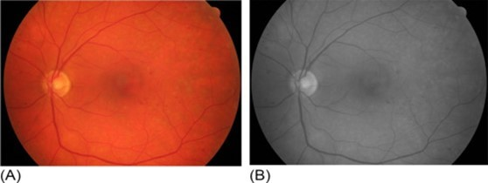
METHODOLOGY
Pre Processing
1. RGB to Grayscale Conversion
Purpose: Simplify image data and enhance feature extraction by focusing on luminance rather than color.
Method: Use the rgb2gray() function in Python, applying the formula:
Gray=(0.2989*R)+(0.5870*G) +(0.1140*B)
2. Image Resizing
Purpose: Ensure uniform input size for deep learning models.
Procedure: Resize images to dimensions 224*224 *3

Slide 16
METHODOLOGY 3. Mathematical Equations i) Accuracy = (TP+TN)/(TP+FP+TN+FN) ii)Precision = TP/(TP+FP) iii) Recall = TP/(TP+FN) iv)F1-Score= 2*((Precision * Recall)/(Precision + Recall)) 4. Tools Used Python, TensorFlow, and Keras for model implementation. OpenCV for image preprocessing. Matplotlib and Seaborn for data visualization.

Slide 17
IMPLEMENTATION
1. Implementation Details
Software Specifications:
Programming Languages: Python.
Frameworks: TensorFlow and Keras for machine learning and deep learning model development.
Libraries: OpenCV for image preprocessing, Matplotlib for visualization, Scikit-learn for Random Forest implementation, and Conventional Neural Network(CNN) techniques.
Development Environment: Google Colab

Slide 18
IMPLEMENTATION Hardware Specifications: Processor: Intel Core i5. GPU: NVIDIA GeForce GTX 1080 for faster training and computation. RAM: 16 GB. Storage: 1 TB SSD for storing datasets and outputs. Challenges Faced and Solutions: 1. Imbalanced Dataset: Challenge: Unequal distribution of glaucoma and normal cases in datasets. Solution: Applied data augmentation techniques such as flipping, rotation, and zooming to balance the dataset.

Slide 19
IMPLEMENTATION
3. Feature Extraction Issues:
Challenge: Difficulty in identifying key glaucoma-related features.
Solution: Converted images to grayscale and enhanced contrast using histogram equalization
4. High Computational Demand:
Challenge: Long training times for deep learning models.
Solution: Leveraged GPU for parallel processing and reduced input image dimensions.

Slide 20
RESULTS & ANALYSIS
1. Results Presentation
The performance of the proposed glaucoma diagnosis framework was evaluated using metrics such as accuracy, precision, recall, and F1-score across four standard datasets: ACRIMA, G1020, ORIGA, and REFUGE.
Key Metrics:
Accuracy: Achieved 94% on average across datasets.
Precision: Averaged 92%, indicating minimal false positives.
Recall (Sensitivity): Averaged 93%, highlighting the model's ability to detect glaucoma cases.
F1-Score: Averaged 92.5%, balancing precision and recall.

Slide 21
RESULTS & ANALYSIS 2. Model Comparison: ResNet50: Showed superior performance with an accuracy of 95%. VGG-16: Achieved an accuracy of 93%. Random Forest: Produced reliable results with an accuracy of 90%. 3. Visualization: Accuracy Graph: A bar chart showing ResNet50, VGG-16, and Random Forest accuracy values. Confusion Matrix: Displayed for each model to highlight true positives, true negatives, false positives, and false negatives. ROC Curve: Illustrated the model's true positive rate against the false positive rate for each classifier.

Slide 22
CONCLUSION and FUTURE SCOPE
Conclusion
This project proposed a hybrid framework for glaucoma diagnosis using machine learning and deep learning techniques. By employing CNN models like ResNet50 and VGG-16, along with Random Forest classifiers, the approach demonstrated high accuracy in identifying glaucoma from retinal fundus images.
Utilizing datasets like ACRIMA ORIGA, G1020, and REFUGE ensured robustness. while preprocessing steps optimized the model performance. Individually, Random Forest got 90%, ResNet50 got 91%,VGG16 got 91.5%, and Finally, the hybrid Framework got 96% Accuracy.

Slide 23
Future Scope Dataset Expansion: Incorporate larger, diverse datasets for better generalizability. Real-Time Use: Optimize the model for clinical deployment on portable devices. Multimodal Integration: Combine fundus imaging with OCT or visual field analysis for precision. Explainability: Develop explainable AI to build trust among ophthalmologists. Model Optimization: Create lightweight models for use in resource-limited systems.
CONCLUSION and FUTURE SCOPE

Slide 24
REFERENCE
1. Glaucoma diagnosis using fundus images via deep learning: A detailed study by S Ajitha, Jhon D Akkara, and MV Judy. https: //www.ncbi.nlm.nih.gov/pmc/articles/PMC8597466/
2. Sireesha Moturi, S.N.Tirumala Rao, Srikanth Vemuru, Grey wolf assisted dragonfly-based weighted rule generation for predicting heart disease and breast cancer, Computerized Medical Imaging and Graphics, Volume 91, 2021, 101936, ISSN 0895-6111, https://doi.org/10.1016/j.compmedimag.2021.101936
3. Ayesha Shoukat, Shahzad Akbar, Syed Ale Hassan Automatic diagnosis of glaucoma from retinal images using deep learning https: //www.ncbi.nlm.nih.gov/pmc/articles/PMC10217711/
4. Moturi, S., Vemuru, S., Tirumala Rao, S. N., Mallipeddi, S. A. (2023). Gray Hma Optimized Hybrid Binary Dragonfly Algorithm rau kev xaiv two xeeb. In: Hassanien, A. E., Castillo, O., Anand, S., Jaiswal, A. (Eds.) International Conference on Innovative Computing and Communications. ICDL 2023. Journal of Networks and Systems, Volume 703. https://doi.org/10.1007/ 978-981-99-3315-0-47

Slide 25
REFERENCE 5. G. Gutte, B. Khair, V. Harney, R. Shamalik thiab S. Chippalkatti https://ieeexplore.ieee.org/document/ 10223519Glaucomaeyediagnosisbasedondeeplearning 6. Sunayna, S.S., Rao, S.N.T., Sireesha, M. (2022) Performance evaluation of machine learning algorithms for breast cancer prediction. Sree Nayak, J., Behera, H., Naik, B., Vimal, S., Pelusi, D. (Eds.) Computational Intelligence in Data Exploration. Ntse Innovation, Systems thiab Technology, Cilt.281. https://doi.org/10. 1007/978-981-16-9447-9-25 7. Sumitra V.; Latha P.; Renuka P.; Swaminathan K. Glaucoma detection using deep learning https://ieeexplore.ieee.org/document/ 10421376 8. Price data were collected through October 2023. Marlene S. Puchaicela-Lozano 1, Luiszhinin-Vera 2, 3, *, Ana J. Andrade-Reyes1, Dayanna M. Baque-Arteaga 1, Carolina Cadena-Morejón 2 Deep Learning for Glaucoma Detection: R-CNN, ResNet-50,and Image Segmentation https://www.researchgate.net/publication/ 375594871-for-Glaucoma-Detection-R-CNN-ResNet-50-and-\ Image-Segmentation

Slide 26
REFERENCE
9. Moturi, S., Vemuru, S., Tirumala Rao, S.N., Mallipeddi, S.A. (2023). Hybrid Binary Dragonfly Algorithm with Grey Wolf Optimization for Feature Selection. In: Hassanien, A.E., Castillo, O., Anand, S., Jaiswal, A. (eds) International Conference on Innovative Computing and Communications. ICICC 2023. Lecture Notes in Networks and Systems, vol 703. Springer, Singapore. https: //doi.org/10.1007/978-981-99-3315-0-47 .
10. The diagnosis of glaucoma is strengthened by an in-depth examination of the fundus image. Please be prepared. https://www.nature. com/articles/s41598-021-99605-1 This should be in a large font, right. You know it’s better to say nothing.
11. Moturi S., Tirumala Rao SN., Vemuru S. (2021) Breast cancer diagnosis based on risk prediction using individual clinical data and machine learning models. Sree: Bhattacharyya D., Thirupathi Rao N. (eds.) Machine Intelligence and Software Computing. Advances in Intelligent Systems and Computing, Vol. 1280. Springer, Singapur. https://doi.org/10.1007/978-981-15-9516-5-37.

Slide 27
QUESTIONS and ANSWERS

Slide 28
ACKNOWLEGEMENTS
We sincerely express our gratitude to all individuals and organizations who provided their valuable support and guidance throughout this project. We extend our heartfelt thanks to our mentors, colleagues, and research collaborators for their insights and encouragement.
For any inquiries or further discussions, please feel free to reach out:
Contact Information:
Email: ddlakshmi2004@gmail.com,skrizwana824@gmail.com,skmubeena665@gmail.com
Phone: 9392316128, 9652372519,9866793665
Thank you for the opportunity to present this work. Your feedback and suggestions are highly appreciated!

